Slide 1
exceptions
Basic I/O

Slide 2
exceptions
Basic Input Output (I/O)
Java platform classes used for basic I/O.
Classes covered in the I/O Streams section are in the java.io package.
Classes covered in the File I/O section are in the java.nio.file package.

Slide 3
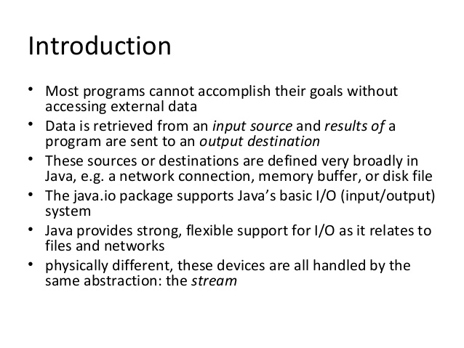
exceptions

Slide 4
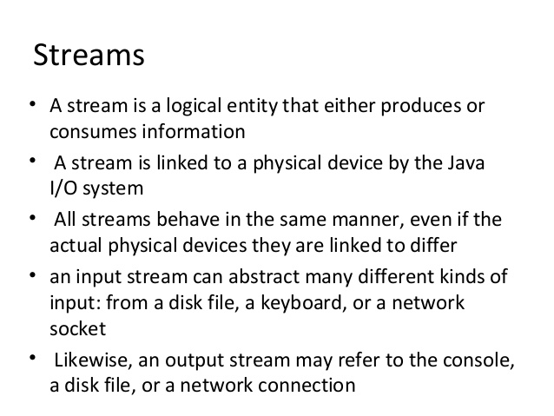
exceptions

Slide 5
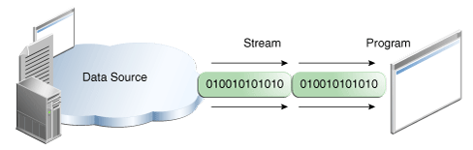
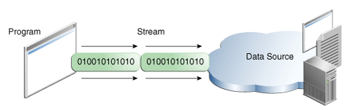
exceptions
I/O Streams
An I/O Stream represents an input source or an output destination.
A stream can represent many different kinds of sources and destinations, including disk files, devices, other programs, and memory arrays.
Streams support many different kinds of data, including simple bytes, primitive data types, localized characters, and objects.
Reading information into a program
Writing information from a program

Slide 6
exceptions
I/O Streams

Slide 7
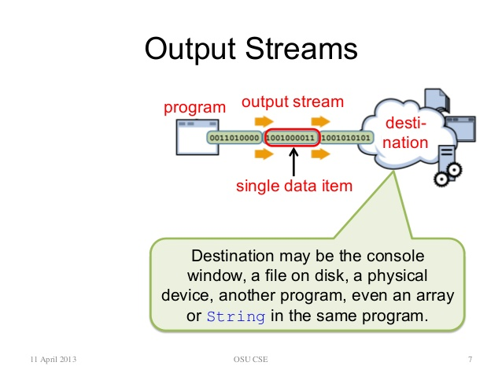
exceptions
I/O Streams

Slide 8
exceptions

Slide 9
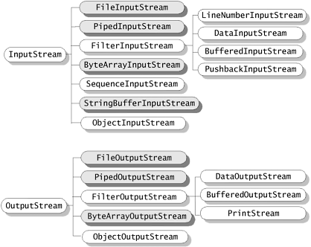
exceptions
Byte Streams
Programs use byte streams to perform input and output of 8-bit bytes.
All byte stream classes are descended from InputStream and OutputStream.
Two most important methods provided by InputStream and OutputStream is read() and write(). They are defined abstract and overridden by derived stream class.
Lab19.1: Demonstration of Byte streams for reading files:

Slide 10
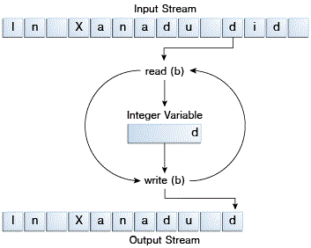
exceptions
Byte Streams…..
Spends most of its time in a simple loop that reads the input stream and writes the output stream, one byte at a time.
Always close stream when no longer needed.

Slide 11
exceptions
Character Streams
Used for handling Unicode character.
Character streams are derived from two super classes Reader and Writer.
Reader and Writer classes define two methods read() and write() which read and write character data. These methods are overridden by derived stream classes.
Input and output done with stream classes automatically translates to and from the local character set.
Character streams is ready for internationalization – all without extra effort by programmer.
The character stream uses the byte stream to perform the physical I/O, while the character stream handles translation between characters and bytes.
An InputStreamReader is a bridge from byte streams to character streams.

Slide 12
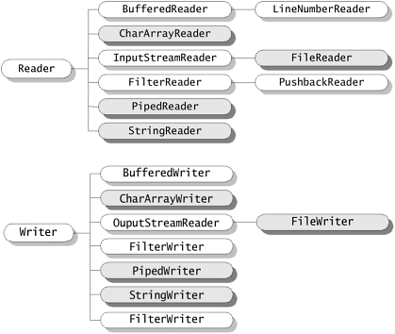
exceptions
Character Streams……
In Byte stream read() methods returns the int value which holds the byte value in its last 8 bits.
In Character stream read() method returns the int value which holds the character value in its last 16 bits.
Lab19.2: Demonstration of Character streams for reading files:

Slide 13
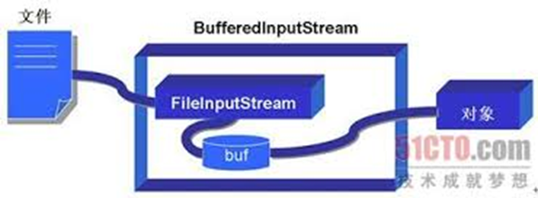
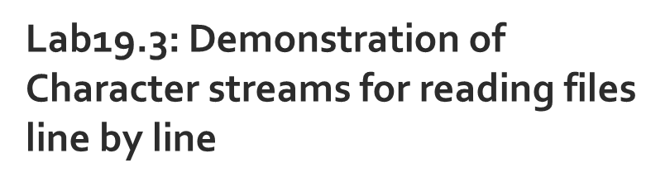
exceptions
Buffered Streams….

Slide 14
exceptions
Buffered Streams
Buffered Streams minimizes disc access for reading or writing files and generally have performance advantage over un buffered streams.
Buffered input streams read data from a memory area known as a buffer; the native input API is called only when the buffer is empty.
Similarly, buffered output streams write data to a buffer, and the native output API is called only when the buffer is full.
A program can convert an unbuffered stream into a buffered stream using the wrapping idiom
inputStream = new BufferedReader(new FileReader("xanadu.txt"));
outputStream = new BufferedWriter(new FileWriter("characteroutput.txt"));
Buffered byte streams - BufferedInputStream and BufferedOutputStream
Buffered character streams - BufferedReader and BufferedWriter

Slide 15
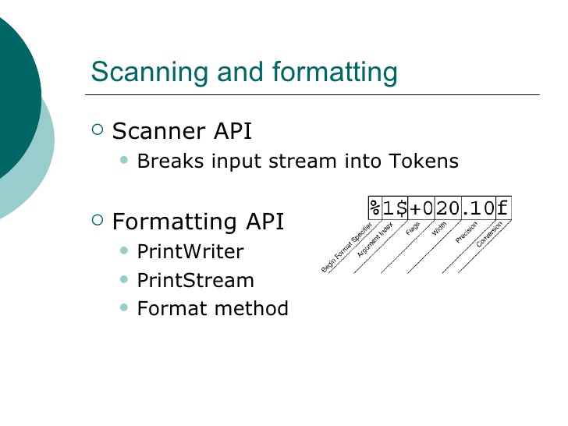
exceptions
Lab19.4: Demonstration of Scanner API
Lab19.5: Demonstration of Scanner API for adding numbers
Lab19.6: Demonstration of print methods.
Lab19.7: Demonstration of format methods

Slide 16
exceptions
I/O from the command line
Standard Streams (All byte streams)
System.out
System.in
System.err
These objects are defined automatically and do not need to be opened.
To use Standard Input as a character stream
InputStreamReader cin = new InputStreamReader(System.in);
The Console (java.io.Console)
Lab19.8: Demonstration of Console object for working with I/O from command line.

Slide 17
exceptions
Data Streams
Support binary I/O of primitive data type values (boolean, char, byte, short, int, long, float, and double) as well as String values.
All data streams implement either the DataInput interface or the DataOutput interface.
Most widely used implementations – DataInputStream , DataOutputStream.
DataStreams detects an end-of-file condition by catching EOFException.
Lab19.9: Demonstration of using Data streams.

Slide 18
exceptions
Object Streams
Supports reading and writing of Objects.
Supports serialization of the objects which implements “Serializable” marker interface.
The object stream classes are ObjectInputStream and ObjectOutputStream.
These classes implement ObjectInput and ObjectOutput, which are subinterfaces of DataInput and DataOutput.
An object stream can contain a mixture of primitive and object values
Print Disabled.Please close any Policy Site if open.
Lab19.10: Demonstration of using Object streams

Slide 19
exceptions

Slide 20
exceptions

Slide 21
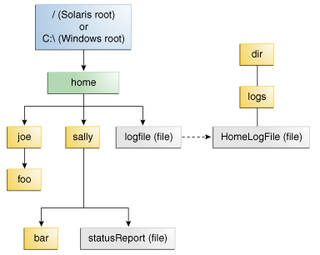
exceptions
File I/O – Path
The java.nio.file package and its related package, java.nio.file.attribute, provide comprehensive support for file I/O and for accessing the default file system.
Path
Relative path Ex: C:\home\sally\statusReport
Absolute path Ex: sally\statusReport
Symbolic Links
logFile appears to be a regular file to the user, but it is actually a symbolic link to dir/logs/HomeLogFile. HomeLogFile is the target of the link

Slide 22
exceptions
File I/O – Path Operations
Creating Path
Ex: Path p1 = Paths.get("/tmp/foo");
Path p2 = Paths.get(args[0]);
Path p3 = Paths.get(URI.create("file:///Users/joe/FileTest.java")); OR
Path p4 = FileSystems.getDefault().getPath("/users/sally");
Lab19.11: Demonstration of creating Path

Slide 23
exceptions
File I/O – Path Operations ….
Converting a Path
Ex: Path p1 = Paths.get("/home/logfile");
// Result is file:///home/logfile
System.out.format("%s%n", p1.toUri());
Path fullPath = inputPath.toAbsolutePath();
try {
Path fp = path.toRealPath();
} catch (NoSuchFileException x) {
System.err.format("%s: no such" + " file or directory%n", path);
// Logic for case when file doesn't exist.
} catch (IOException x) {
System.err.format("%s%n", x);
// Logic for other sort of file error.
}

Slide 24
exceptions
File I/O – Path Operations ….
Joining two paths
Ex:// Solaris
Path p1 = Paths.get("/home/joe/foo");
// Result is /home/joe/foo/bar
System.out.format("%s%n", p1.resolve("bar"));
Creating a Path Between Two Paths
Path p1 = Paths.get("joe");
Path p2 = Paths.get("sally");
// Result is ../sally
Path p1_to_p2 = p1.relativize(p2);
// Result is ../joe
Path p2_to_p1 = p2.relativize(p1);

Slide 25
exceptions
File I/O – Path Operations ….
Comparing two paths
Ex: Path path = ...;
Path otherPath = ...;
Path beginning = Paths.get("/home");
Path ending = Paths.get("foo");
if (path.equals(otherPath)) {
// equality logic here
} else if (path.startsWith(beginning)) {
// path begins with "/home"
} else if (path.endsWith(ending)) {
// path ends with "foo"
}
Lab19.12: Demonstration of Working with Path

Slide 26
exceptions
File Operations
The Files class is the other primary entrypoint of the java.nio.file package.
Files offers a rich set of static methods for reading, writing, and manipulating files and directories.
Close method must be invoked to release the resource when no longer required. Neglecting to close a resource can have a negative implication on an application's performance.
All methods that access the file system can throw an IOException.
Every Files method either detects what to do when a symbolic link is encountered, or it provides an option enabling you to configure the behavior when a symbolic link is encountered.
Files class can accept pattern matching behavior using Glob pattern.
*.html – Matches all strings that end in .html
??? – Matches all strings with exactly three letters or digits
*[0-9]* – Matches all strings containing a numeric value
*.{htm,html,pdf} – Matches any string ending with .htm, .html or .pdf
a?*.java – Matches any string beginning with a, followed by at least one letter or digit, and ending with .java
{foo*,*[0-9]*} – Matches any string beginning with foo or any string containing a numeric value

Slide 27
exceptions
File Operations - Checking a File or Directory
Verifying the Existence of a File or Directory
exists(Path, LinkOption...) – Checks if the given file exists
notExists(Path, LinkOption...) – Checks if the given file doesn’t exist.
!Files.exists(path) is not equivalent to Files.notExists(path)
If both exists and notExists return false, the existence of the file cannot be verified.
Checking File Accessibility
isReadable(Path), isWritable(Path), and isExecutable(Path) methods.
Ex:
Path file = ...;
boolean isRegularExecutableFile = Files.isRegularFile(file) & Files.isReadable(file) & Files.isExecutable(file);
Checking Whether Two Paths Locate the Same File
Ex: isSameFile(Path, Path) method compares two paths to determine if they locate the same file on the file system.

Slide 28
exceptions
File Operations – Deleting File/Directory
The delete(Path) method deletes the file or throws an exception if the deletion fails.
The deleteIfExists(Path) method also deletes the file, but if the file does not exist, no exception is thrown
Ex:
try {
Files.delete(path);
} catch (NoSuchFileException x) {
System.err.format("%s: no such" + " file or directory%n", path);
} catch (DirectoryNotEmptyException x) {
System.err.format("%s not empty%n", path);
} catch (IOException x) {
// File permission problems are caught here.
System.err.println(x);
}

Slide 29
exceptions
File Operations – Copying a File/Directory
You can copy a file or directory by using the copy(Path, Path, CopyOption...) method.
Copy Options :
REPLACE_EXISTING – Performs the copy even when the target file already exists.
COPY_ATTRIBUTES – Copies the file attributes associated with the file to the target file.
NOFOLLOW_LINKS – Indicates that symbolic links should not be followed.
The copy(InputStream, Path, CopyOptions...) method may be used to copy all bytes from an input stream to a file.
The copy(Path, OutputStream) method may be used to copy all bytes from a file to an output stream.
Ex:
import static java.nio.file.StandardCopyOption.*;
...
Files.copy(source, target, REPLACE_EXISTING);
Lab19.13: Demonstration of File copying

Slide 30
exceptions
File Operations – Moving a File/Directory
You can move a file or directory by using the move(Path, Path, CopyOption...).
StandardCopyOption:
REPLACE_EXISTING – Performs the move even when the target file already exists.
ATOMIC_MOVE – Performs the move as an atomic file operation. If the file system does not support an atomic move, an exception is thrown.
Ex:
import static java.nio.file.StandardCopyOption.*;
...
Files.move(source, target, REPLACE_EXISTING);

Slide 31
exceptions
File Operations – Managing Meta data
Files class provides various methods for managing meta data (i.e. data about data).

Slide 32
exceptions
File Operations – Managing Meta data …..

Slide 33
exceptions
File Operations – Managing Meta data …..
Attribute Views
Different file systems have different notions about which attributes should be tracked.
The supported views are as follows:
BasicFileAttributeView – Basic attributes that are required to be supported by all file system implementations.
DosFileAttributeView – Extends the basic attribute view with the standard four bits supported on file systems that support the DOS attributes.
PosixFileAttributeView – Extends the basic attribute view with attributes supported on file systems that support the POSIX family of standards, such as UNIX. These attributes include file owner, group owner, and the nine related access permissions.
FileOwnerAttributeView – Supported by any file system implementation that supports the concept of a file owner.
AclFileAttributeView – Supports reading or updating a file's Access Control Lists (ACL). The NFSv4 ACL model is supported. Any ACL model, such as the Windows ACL model, that has a well-defined mapping to the NFSv4 model might also be supported.
UserDefinedFileAttributeView – Enables support of metadata that is user defined. This view can be mapped to any extension mechanisms that a system supports. In the Solaris OS, for example, you can use this view to store the MIME type of a file.

Slide 34
exceptions
File Operations – Managing Meta data …..
You can use the FileStore class to learn information about a file store, such as how much space is available.
The getFileStore(Path) method fetches the file store for the specified file.
Ex:
Path file = ...;
FileStore store = Files.getFileStore(file);
long total = store.getTotalSpace() / 1024;
long used = (store.getTotalSpace() -
store.getUnallocatedSpace()) / 1024;
long avail = store.getUsableSpace() / 1024;
Lab19.14: Demonstration of fetching Files metadata.
Lab19.15: Demonstration of using FileStore for finding disk usage.

Slide 35
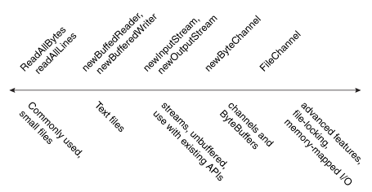
exceptions
File Operations – Reading, Writing and Creating Files

Slide 36
exceptions
File Operations – Reading, Writing and Creating Files…….
Reading All Bytes or Lines from a File.
Used for reading small files and to read the entire content of the file in one pass.
you can use the readAllBytes(Path) or readAllLines(Path, Charset) method.
Path file = ...;
byte[] fileArray;
fileArray = Files.readAllBytes(file);

Slide 37
exceptions
File Operations – Reading, Writing and Creating Files…….
Writing All Bytes or Lines to a File.
You can use one of the write methods to Write bytes, or lines, to a file.
write(Path, byte[], OpenOption...)
write(Path, Iterable< extends CharSequence>, Charset, OpenOption...)
Ex:
Path file = ...;
byte[] buf = ...;
Files.write(file, buf);

Slide 38
exceptions
File Operations – Reading, Writing and Creating Files…….
The following StandardOpenOptions enums are supported:
WRITE – Opens the file for write access.
APPEND – Appends the new data to the end of the file. This option is used with the WRITE or CREATE options.
TRUNCATE_EXISTING – Truncates the file to zero bytes. This option is used with the WRITE option.
CREATE_NEW – Creates a new file and throws an exception if the file already exists.
CREATE – Opens the file if it exists or creates a new file if it does not.
DELETE_ON_CLOSE – Deletes the file when the stream is closed. This option is useful for temporary files.
SPARSE – Hints that a newly created file will be sparse. This advanced option is honored on some file systems, such as NTFS, where large files with data "gaps" can be stored in a more efficient manner where those empty gaps do not consume disk space.
SYNC – Keeps the file (both content and metadata) synchronized with the underlying storage device.
DSYNC – Keeps the file content synchronized with the underlying storage device.

Slide 39
exceptions
File Operations – Reading, Writing and Creating Files…….
Reading a File by Using Buffered Stream I/O
Use newBufferedReader(Path, Charset) method for reading file.
Ex:
Charset charset = Charset.forName("US-ASCII");
try (BufferedReader reader = Files.newBufferedReader(file, charset)) {
String line = null;
while ((line = reader.readLine()) != null) {
System.out.println(line);
}
} catch (IOException x) {
System.err.format("IOException: %s%n", x);
}

Slide 40
exceptions
File Operations – Reading, Writing and Creating Files…….
Writing a File by Using Buffered Stream I/O
Use the newBufferedWriter(Path, Charset, OpenOption...) method.
Ex:
Charset charset = Charset.forName("US-ASCII");
String s = ...;
try (BufferedWriter writer = Files.newBufferedWriter(file, charset)) {
writer.write(s, 0, s.length());
} catch (IOException x) {
System.err.format("IOException: %s%n", x);
}

Slide 41
exceptions
File Operations – Reading, Writing and Creating Files…….
Reading a File by Using unbuffered Stream I/O
You can use the newInputStream(Path, OpenOption...) method.
Ex:
Path file = ...;
try (InputStream in = Files.newInputStream(file);
BufferedReader reader =
new BufferedReader(new InputStreamReader(in))) {
String line = null;
while ((line = reader.readLine()) != null) {
System.out.println(line);
}
} catch (IOException x) {
System.err.println(x);
}

Slide 42
exceptions
File Operations – Reading, Writing and Creating Files…….
Writing a File by Using unbuffered Stream I/O
You can use the newOutputStream(Path, OpenOption...) method.
Ex:
try (OutputStream out = new BufferedOutputStream(
Files.newOutputStream(p, CREATE, APPEND))) {
out.write(data, 0, data.length);
} catch (IOException x) {
System.err.println(x);
}

Slide 43
exceptions
File Operations – Reading, Writing and Creating Files…….
try (SeekableByteChannel sbc = Files.newByteChannel(file)) {
ByteBuffer buf = ByteBuffer.allocate(10);
// Read the bytes with the proper encoding for this platform. If
// you skip this step, you might see something that looks like
// Chinese characters when you expect Latin-style characters.
String encoding = System.getProperty("file.encoding");
while (sbc.read(buf) > 0) {
buf.rewind();
System.out.print(Charset.forName(encoding).decode(buf));
buf.flip();
}
} catch (IOException x) {
System.out.println("caught exception: " + x);
Reading and Writing Files by Using Channel I/O
While stream I/O reads a character at a time, channel I/O reads a buffer at a time
A SeekableByteChannel is a ByteChannel that has the capability to maintain a position in the channel and to change that position.
A SeekableByteChannel also supports truncating the file associated with the channel and querying the file for its size.
newByteChannel(Path, OpenOption...)
newByteChannel(Path, Set<? extends OpenOption>, FileAttribute<?>...).
SeekableByteChannel supports both reading and writing

Slide 44
exceptions
File Operations – Reading, Writing and Creating Files…….
Creating Regular Files:
Use the createFile(Path, FileAttribute<?>) method.
Ex:
Path file = ...;
try {
// Create the empty file with default permissions, etc.
Files.createFile(file);
} catch (FileAlreadyExistsException x) {
System.err.format("file named %s" +
" already exists%n", file);
} catch (IOException x) {
// Some other sort of failure, such as permissions.
System.err.format("createFile error: %s%n", x);
}

Slide 45
exceptions
File Operations – Reading, Writing and Creating Files…….
Creating temporary files:
You can create a temporary file using one of the following createTempFile methods:
createTempFile(Path, String, String, FileAttribute<?>)
createTempFile(String, String, FileAttribute<?>)
Ex:
try {
Path tempFile = Files.createTempFile(null, ".myapp");
System.out.format("The temporary file" +
" has been created: %s%n", tempFile);
} catch (IOException x) {
System.err.format("IOException: %s%n", x);
}
Lab19.16: Demonstration of File reading and writing

Slide 46
exceptions
File Operations – Random Access File
Random access files permit non-sequential, or random, access to a file's contents.
This functionality is possible with the SeekableByteChannel interface.
Path.newByteChannel methods return an instance of a SeekableByteChannel.
SeekableByteChannel API consists of a few, easy to use, methods
position – Returns the channel's current position
position(long) – Sets the channel's position
read(ByteBuffer) – Reads bytes into the buffer from the channel
write(ByteBuffer) – Writes bytes from the buffer to the channel
truncate(long) – Truncates the file (or other entity) connected to the channel
Lab19.17: Demonstration of Random Access File:

Slide 47
exceptions
File Operations – Working with directories
Listing a File System's Root Directories
Ex:
Iterable<Path> dirs = FileSystems.getDefault().getRootDirectories();
for (Path name: dirs) {
System.err.println(name);
}
Creating a Directory
Ex:
Path dir = ...;
Files.createDirectory(path);

Slide 48
exceptions
File Operations – Working with directories
Creating a Temporary Directory
createTempDirectory(Path, String, FileAttribute<?>...)
createTempDirectory(String, FileAttribute<?>...)
Listing a Directory's Contents
Use Files.newDirectoryStream(Path) method.
This method returns an object that implements the DirectoryStream interface.
The returned DirectoryStream is a stream. If you are not using a try-with-resources statement, don't forget to close the stream in the finally block
Path dir = ...;
try (DirectoryStream<Path> stream = Files.newDirectoryStream(dir)) {
for (Path file: stream) {
System.out.println(file.getFileName());
}
} catch (IOException | DirectoryIteratorException x) {
System.err.println(x);
}

Slide 49
exceptions
File Operations – Working with directories
Filtering a Directory Listing By Using Globbing
Ex:
Path dir = ...;
try (DirectoryStream<Path> stream =
Files.newDirectoryStream(dir, "*.{java,class,jar}")) {
for (Path entry: stream) {
System.out.println(entry.getFileName());
}
} catch (IOException x) {
// IOException can never be thrown by the iteration.
// In this snippet, it can // only be thrown by newDirectoryStream.
System.err.println(x);
}

Slide 50
exceptions
File Operations – Working with Links
Creating a Symbolic Link:
Ex:
Path newLink = ...;
Path target = ...;
try {
Files.createSymbolicLink(newLink, target);
} catch (IOException x) {
System.err.println(x);
} catch (UnsupportedOperationException x) {
// Some file systems do not support symbolic links.
System.err.println(x);
}

Slide 51
exceptions
File Operations – Working with Links
Creating a hard Link:
Ex:
Path newLink = ...;
Path existingFile = ...;
try {
Files.createLink(newLink, existingFile);
} catch (IOException x) {
System.err.println(x);
} catch (UnsupportedOperationException x) {
// Some file systems do not
// support adding an existing
// file to a directory.
System.err.println(x);
}
Target file or directory must exist or a NoSuchFileException is thrown..

Slide 52
exceptions
File Operations – Working with Links
Detecting a symbolic link:
Ex:
Path file = ...;
boolean isSymbolicLink = Files.isSymbolicLink(file);
Finding the Target of a Link
Ex:
Path link = ...;
try {
System.out.format("Target of link" +
" '%s' is '%s'%n", link,
Files.readSymbolicLink(link));
} catch (IOException x) {
System.err.println(x);
}
Lab19.19: Demonstration of working with Links:

Slide 53
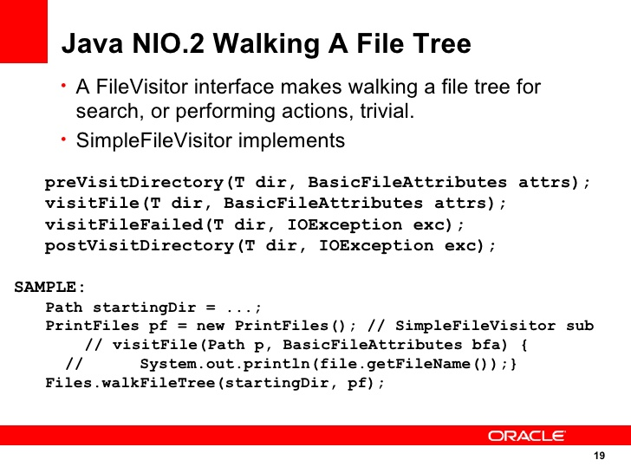
exceptions
File Operations – Walking a file tree
Lab19.20: Using FileVisitor for walking the file tree
Lab19.21: Using FileVisitor for Finding files

Slide 54
exceptions
File Operations – Working with directories

Slide 55
exceptions
File I/O

Slide 56
exceptions
File I/O (Prior to SE7)
Mapping java.io.File Functionality to java.nio.file

Slide 57
exceptions
File I/O (Prior to SE7)…….

Slide 58
exceptions
File I/O (Prior to SE7)…….

Slide 59
exceptions
File I/O (Prior to SE7)…….

Slide 60
exceptions

Slide 61
Java - miscellaneous
Type Comparison Operator instanceof
The instanceof operator compares an object to a specified type.
You can use it to test if an object is an instance of a class, an instance of a subclass, or an instance of a class that implements a particular interface
Classes implementing interfaces
class MyClass extends MySuperClass implements YourInterface {
// field, constructor, and
// method declarations
}

Slide 62
Java - miscellaneous
Varargs – Specifying Arbitrary number of arguments
public Polygon polygonFrom(Point... corners) {
int numberOfSides = corners.length;
double squareOfSide1, lengthOfSide1;
squareOfSide1 = (corners[1].x - corners[0].x)
* (corners[1].x - corners[0].x)
+ (corners[1].y - corners[0].y)
* (corners[1].y - corners[0].y);
lengthOfSide1 = Math.sqrt(squareOfSide1);
// more method body code follows that creates and returns a
// polygon connecting the Points
}
You will most commonly see varargs with the printing methods; for example, this printf method:
public PrintStream printf(String format, Object... args)
allows you to print an arbitrary number of objects. It can be called like this:
System.out.printf("%s: %d, %s%n", name, idnum, address);

Slide 63
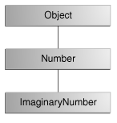
Java - miscellaneous
Returning a Class or Interface
When a method uses a class name as its return type the class of the type of the returned object must be either a subclass of, or the exact class of, the return type.
public Number returnANumber() {
...
}
The returnANumber method can return an ImaginaryNumber but not an Object. ImaginaryNumber is a Number because it's a subclass of Number. However, an Object is not necessarily a Number — it could be a String or another type

Slide 64
Advanced java
Garbage collection
JDBC
Lambda expressions
Annotations
Aggregate operations on collection using Lambarda expression.
Java streaming
Blocking queue
Aggregate operations
Autoboxing and unboxing

Slide 65
https://docs.oracle.com/javase/tutorial/reallybigindex.html
http://www.slideshare.net/EdurekaIN/java-class-3
http://www.slideshare.net/abdurrehmanabdurrehman391/variables-and-data-types-by-sir-khalid
http://www.slideshare.net/abdurrehmanabdurrehman391/java-advancedoop
http://www.slideshare.net/MindfireSolutions/java-garbage-collection-how-it-works?next_slideshow=1
http://www.slideshare.net/arnold7490/unit-4-java
http://www.slideshare.net/arnold7490/unit-3-java?next_slideshow=1
http://www.slideshare.net/tushardesarda/java-tutorial-3
http://www.slideshare.net/muralidhar9e/java-exception-handling-ppt
http://www.slideshare.net/emprovise/2-javabasics
http://www.slideshare.net/AllanHuang/java-new-evolution
http://www.slideshare.net/antonkeks/4-collections
http://www.slideshare.net/andreaiacono/java8-39841939 - Java8 features
http://www.slideshare.net/AbhishekKhune/07-java-collection
http://www.slideshare.net/shahjahan786/generics-27960064 - Generics
http://www.slideshare.net/caroljmcdonald/java-generics-2485138?next_slideshow=1

Slide 66
http://www.slideshare.net/KavitaGanesan/is-66154415-kavitaganesanv2 - Strings
http://www.slideshare.net/antonkeks/10-threads - Threads
http://www.slideshare.net/BenjDelMundo/java-thread-synchronization - Synchronization
http://www.slideshare.net/javaonkar/thread-concurrancy - Synchronization
http://www.slideshare.net/lineking/io-package - Basic IO
http://new.51cto.com – Buffered streams.
http://www.slideshare.net/EmertxeSlides/010-core-javaiofundamentals - IO
http://www.slideshare.net/martyhall/file-io-in-java-8-applying-the-power-of-streams - File IO

